Slide 1
Swap p15A in for ColE1 in pJ66 (pHps2 RFP pCM66T)

Slide 2
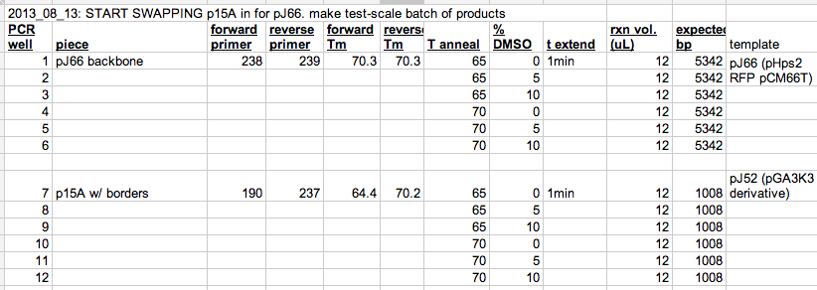
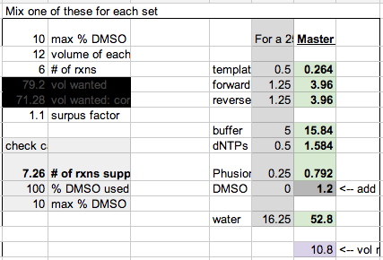
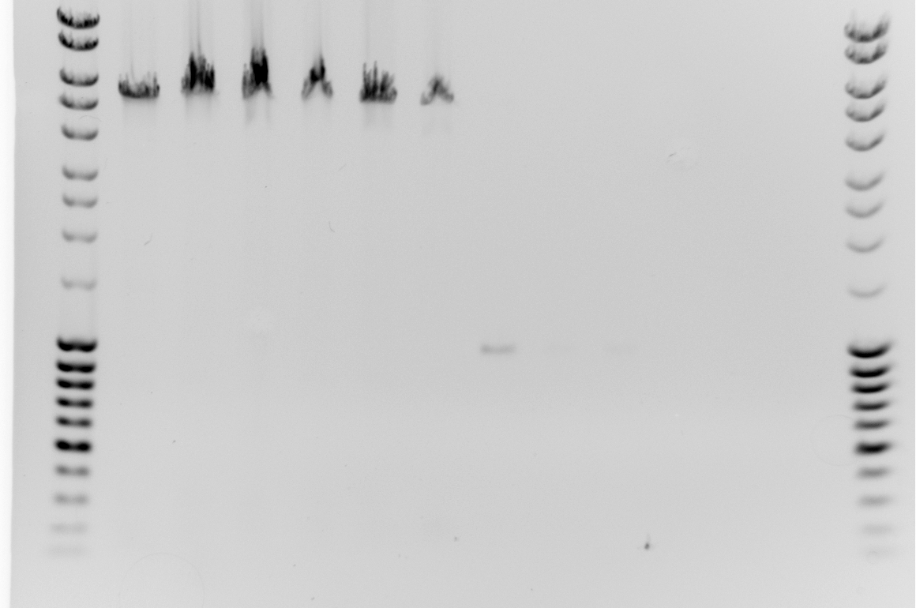

Slide 3

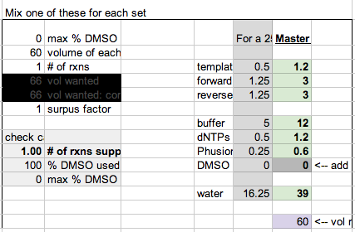
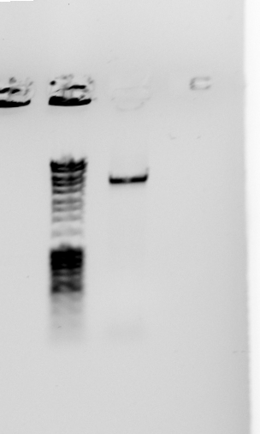
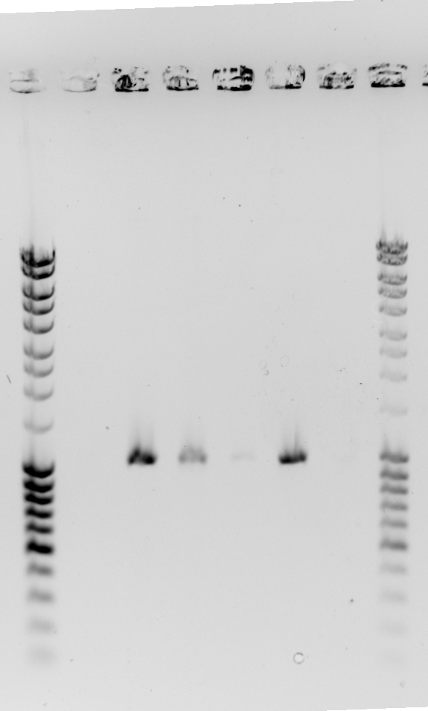
Well 13 – gel purification needed. Add Dpn1.
Wels 14-19: Make purification scale of well 15.

Slide 4

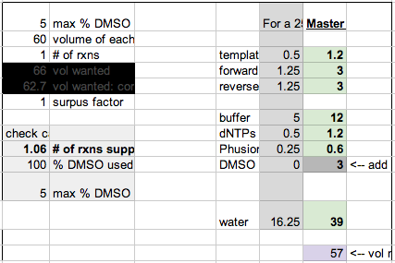

test-scale (3uL) gel of product 20.
0.5 uL Dpn1 added for ~ 1hr at 37oC.

Slide 5
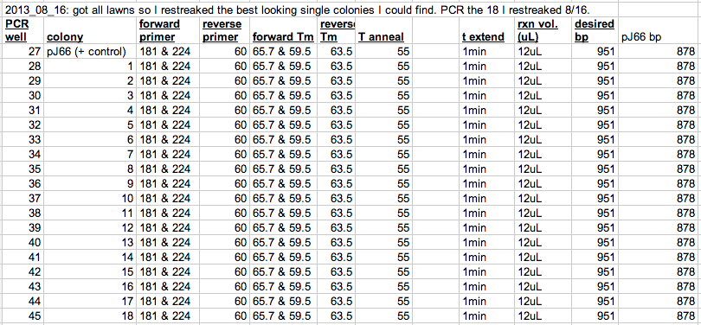
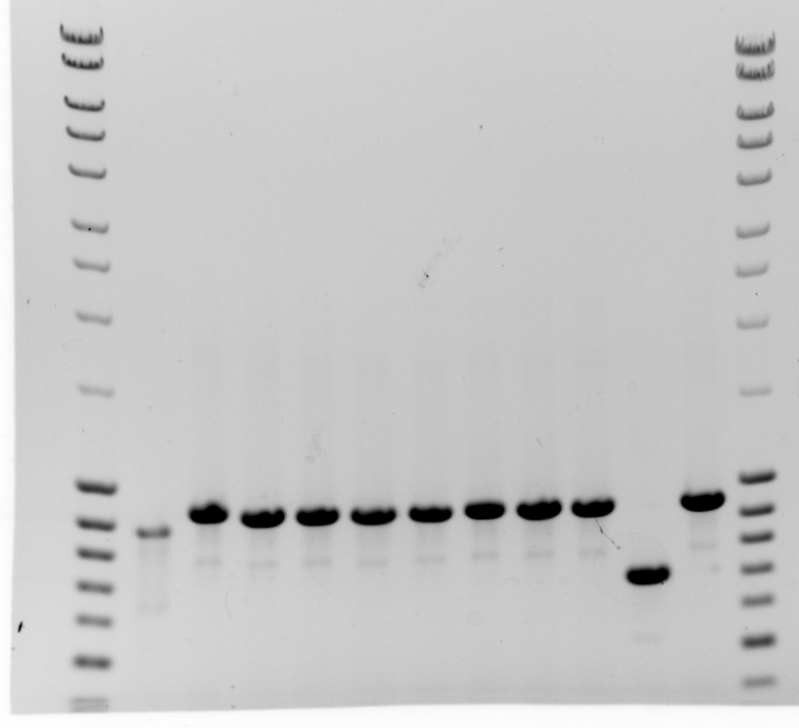
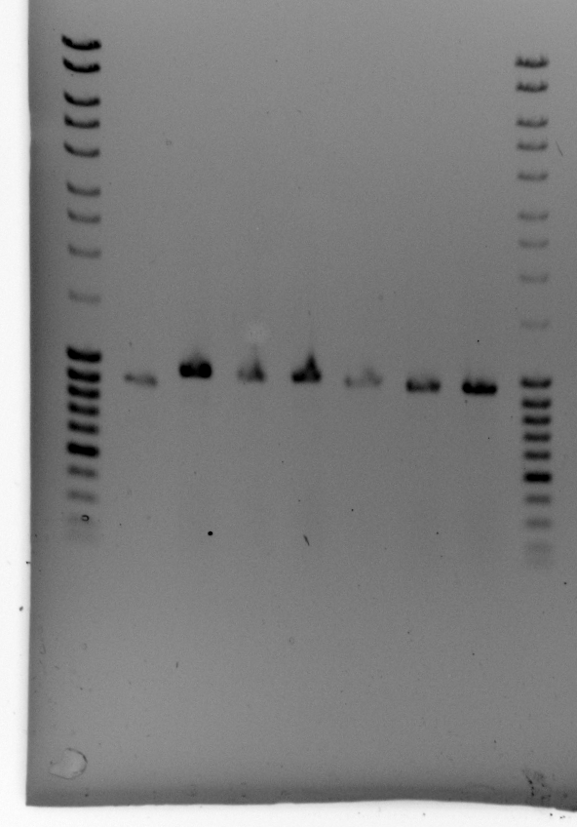
Wells 27 (control) and colonies 1-10. Are they all good? Run 1 uL to make skinnier bands & be sure.

Slide 6

